Slide 1
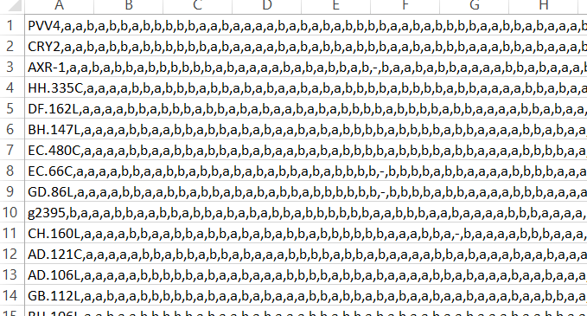
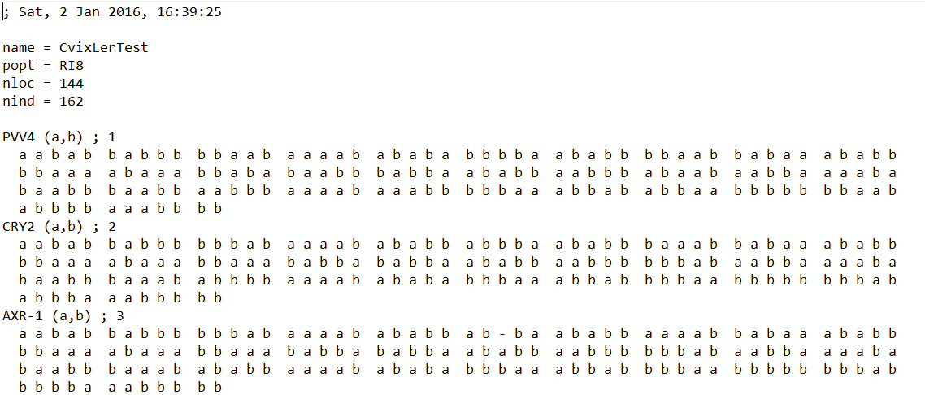
Python program
Python 3.6
Short program to make it more easily for R to extract the data

Slide 2
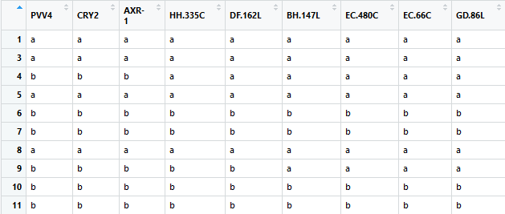
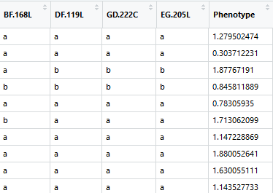
R program
R 3.3.2 used in Rstudio 1.1.383
Extract data from files and create a table
Isolate each marker and phenotype value and preform ANOVA.
…

Slide 3
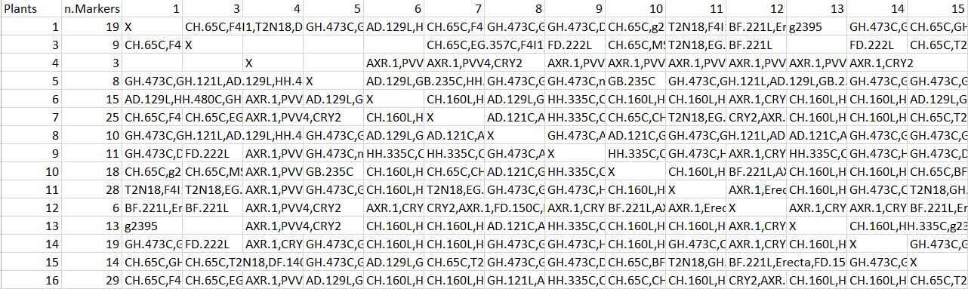
Product
An Excel file with the ANOVA results and other handy information.
Result: from 144 marker remained 33 with a P-value under 0.05

